Slide 1
Flight price prediction
Anyone who has booked a flight ticket knows how unexpectedly the prices vary. The cheapest available ticket on a given flight gets more and less expensive over time. This usually happens as an attempt to maximize revenue based on -
Time of purchase patterns (making sure last-minute purchases are expensive)
Keeping the flight as full as they want it (raising prices on a flight which is filling up in order to reduce sales and hold back inventory for those expensive last-minute expensive purchases)

Slide 2
Exercise:
Data Collection Phase
In this section you have to scrape the data of flights from different websites (yatra.com, skyscanner.com, official websites of airlines, etc). The number of columns for data doesn’t have limit, it’s up to you and your creativity. Generally, these columns areairline name, date of journey, source, destination, route, departure time, arrival time, duration, total stops and the target variable price. You can make changes to it, you can add or you can remove some columns, it completely depends on the website from which you are fetching the data.
Data Analysis
After cleaning the data, you have to do some analysis on the data.
Do airfares change frequently? Do they move in small increments or in large jumps? Do they tend to go up or down over time?
What is the best time to buy so that the consumer can save the most by taking the least risk? Does price increase as we get near to departure date? Is Indigo cheaper than Jet Airways? Are morning flights expensive?

Slide 3
Model Building Phase
After collecting the data, you need to build a machine learning model. Before model building do all data pre-processing steps. Try different models with different hyper parameters and select the best model.
Follow the complete life cycle of data science. Include all the steps like
1. Data Cleaning
2. Exploratory Data Analysis
3. Data Pre-processing
4. Model Building
5. Model Evaluation
6. Selecting the best model

Slide 4
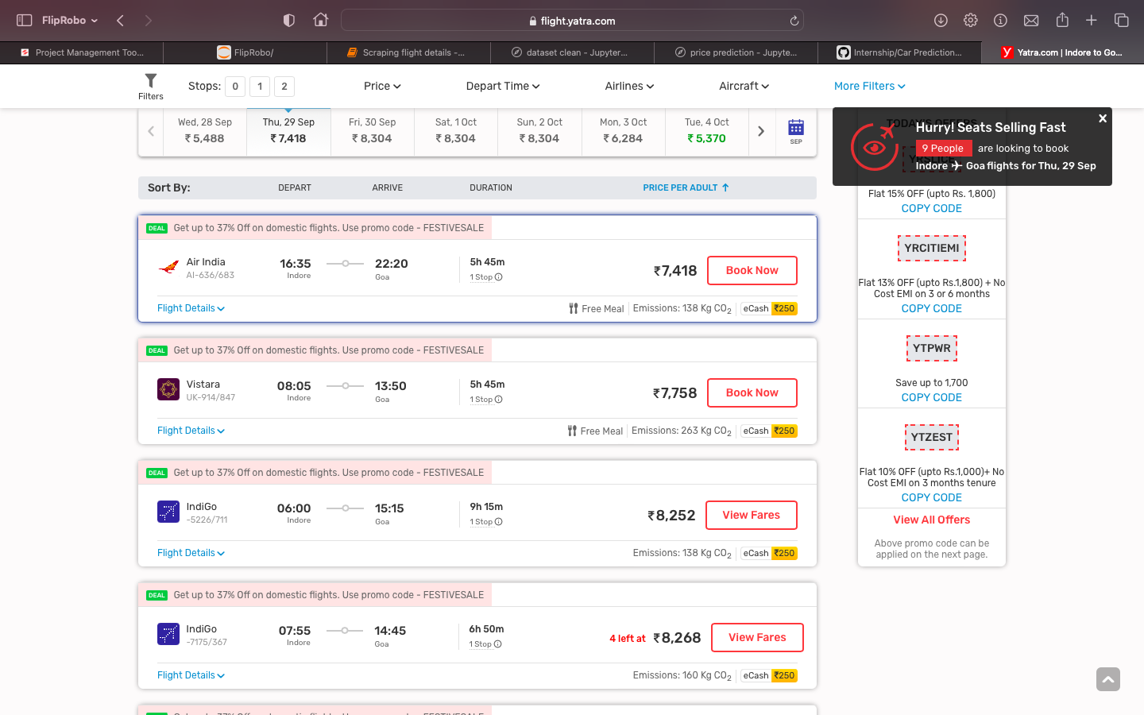
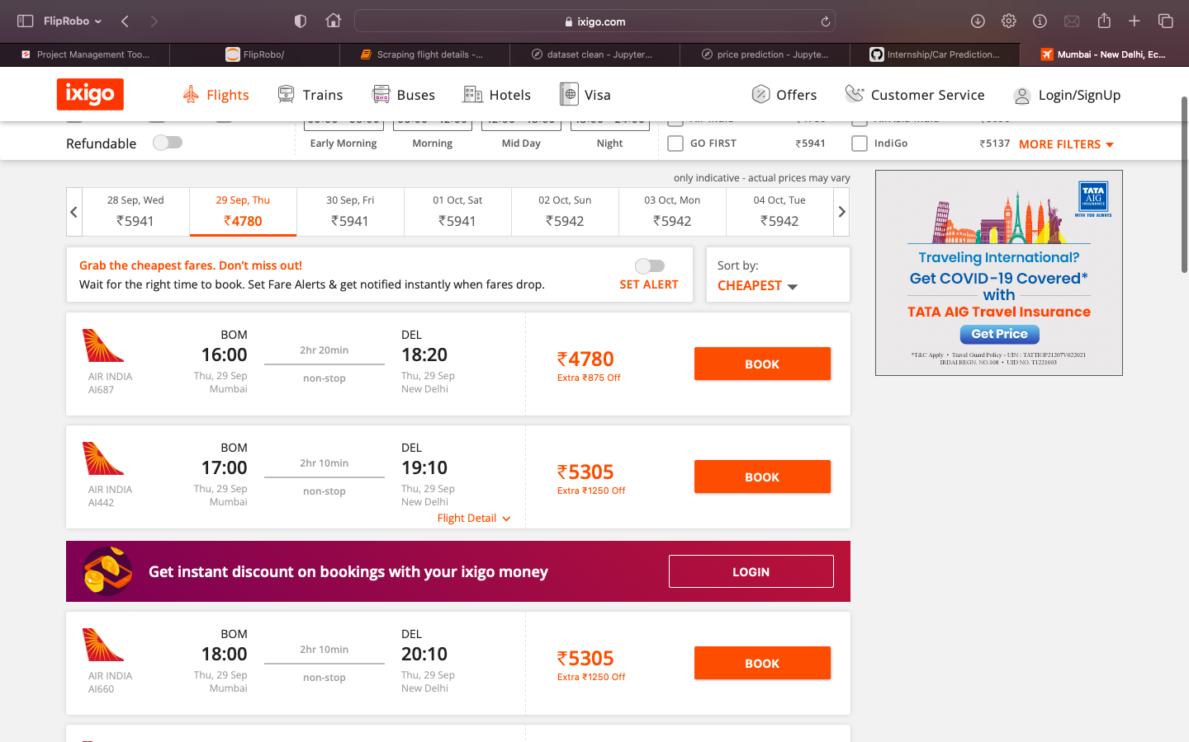
Data Collection Phase
Collected data from different websites such as
www.yatra.com
www.ixigo.com

Slide 5
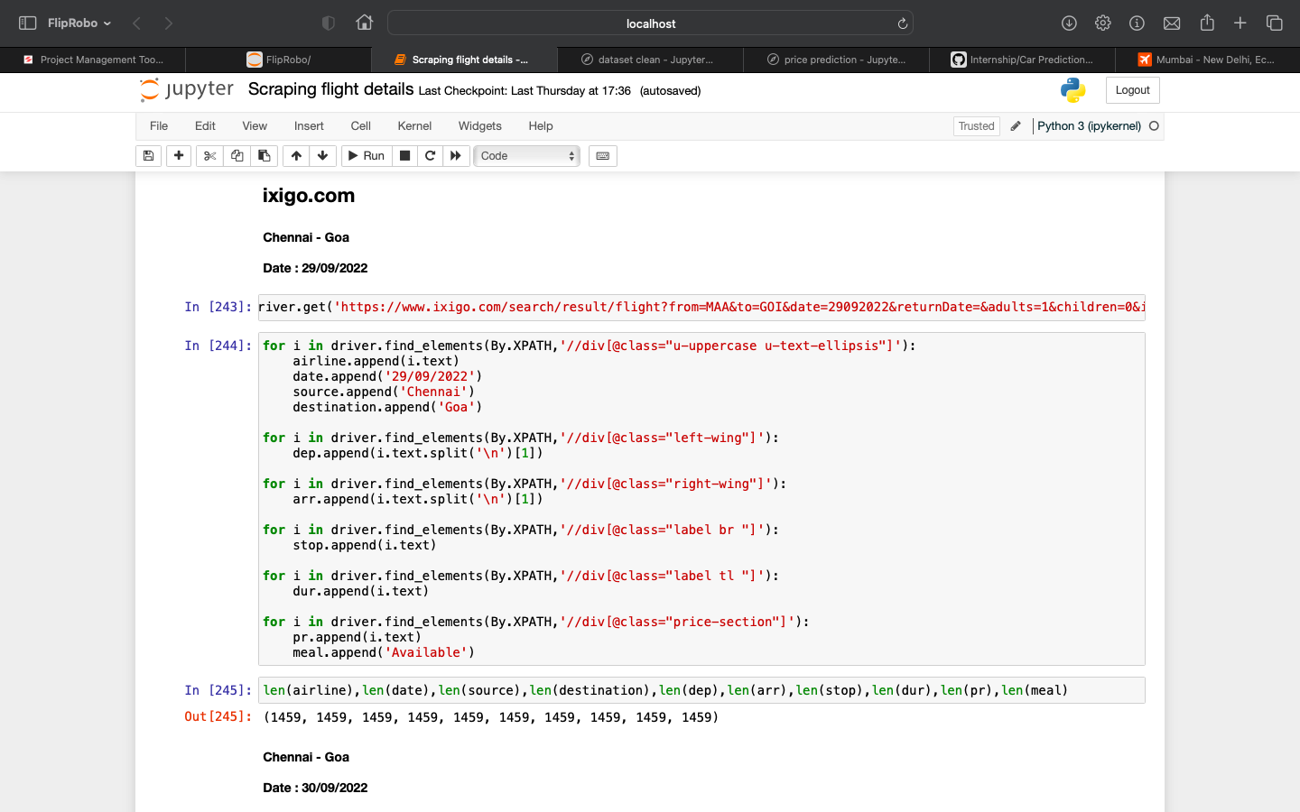
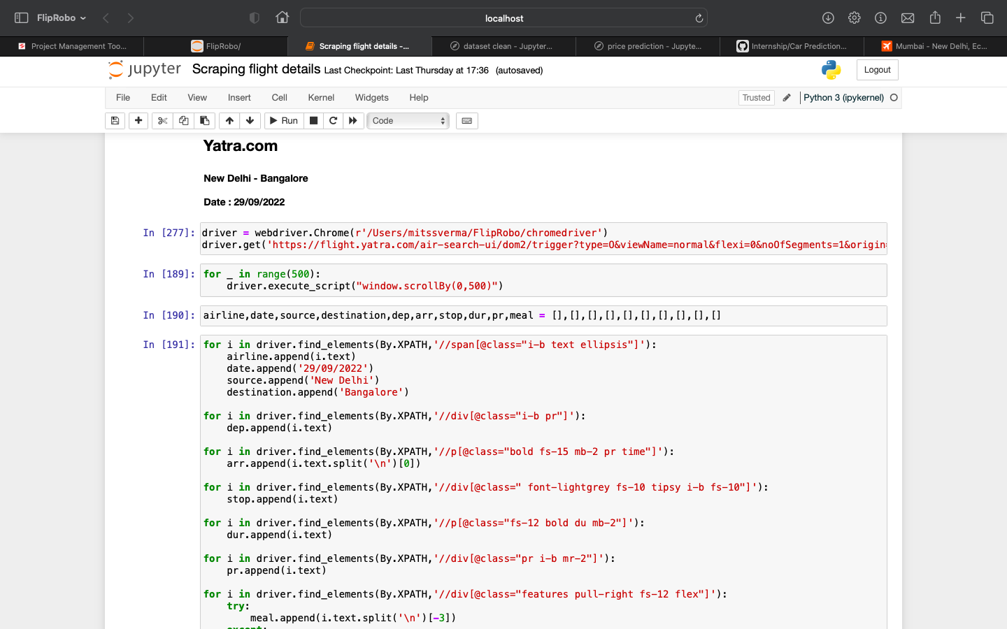
Collected data using Selenium.

Slide 6
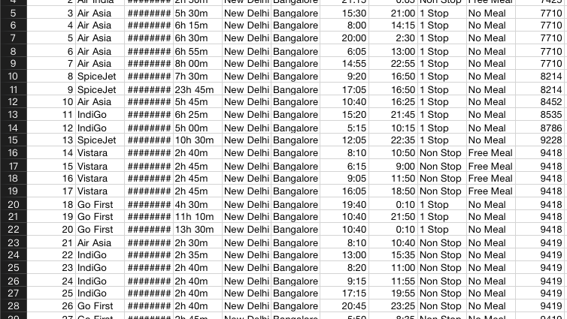
DataFrame/ CSV file
Edited csv file in MS Excel and using Python Pandas

Slide 7
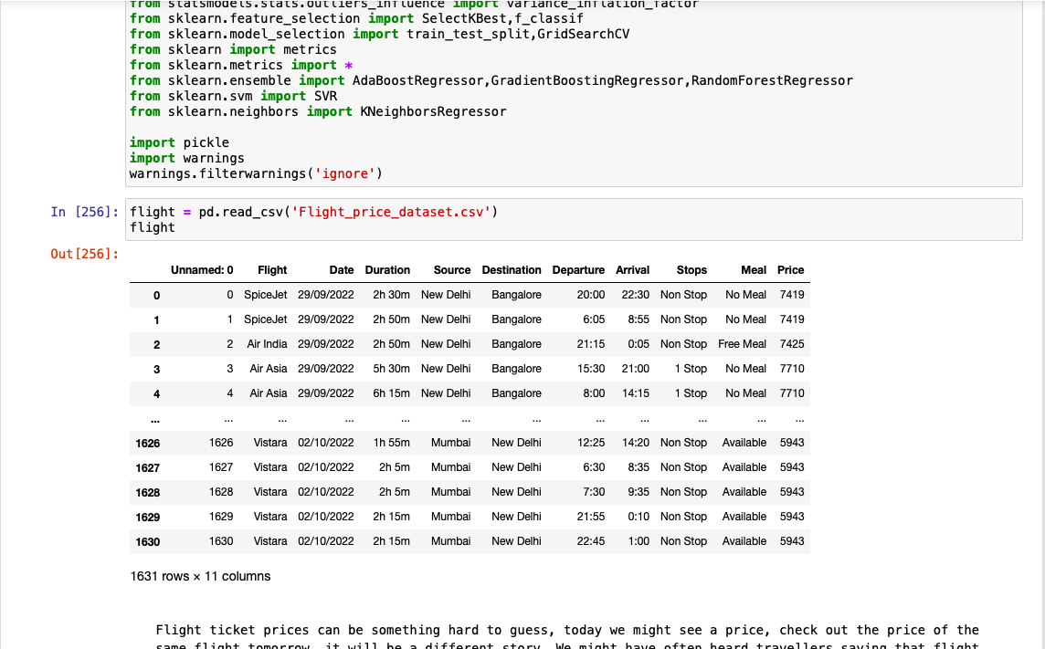
Model Building Phase

Slide 8
EDA
Shape of the dataset.
Information of the dataset.
Data cleaning.

Slide 9
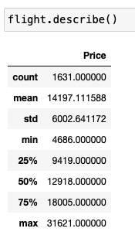
Descriptive Statistic:

Slide 10
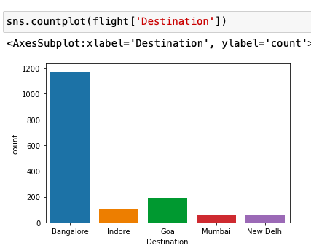
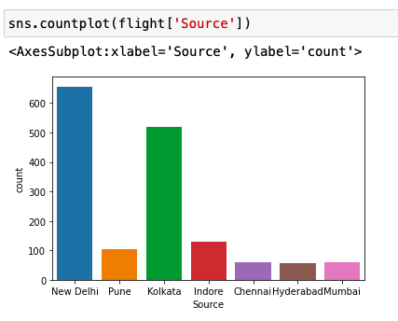
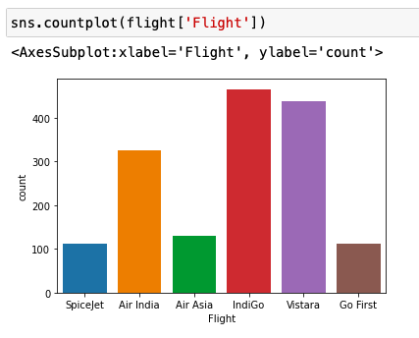
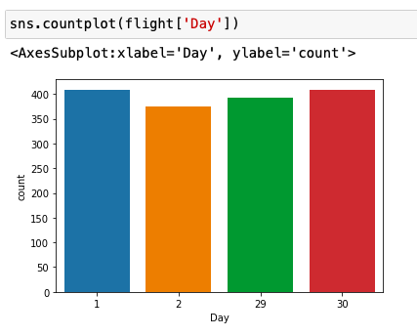
Visualization
- Univariate Analysis.

Slide 11
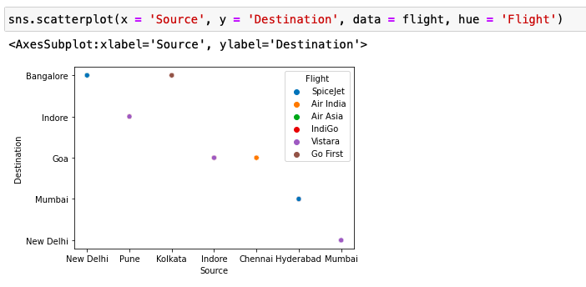
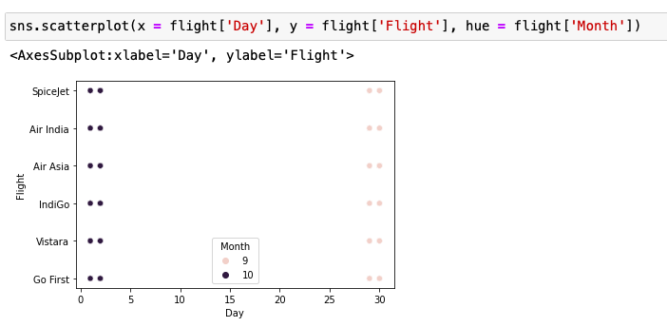
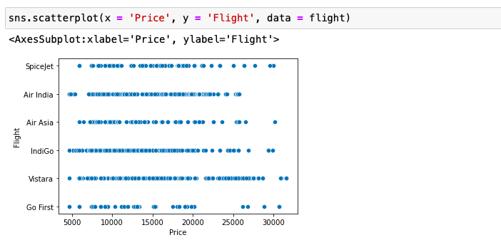
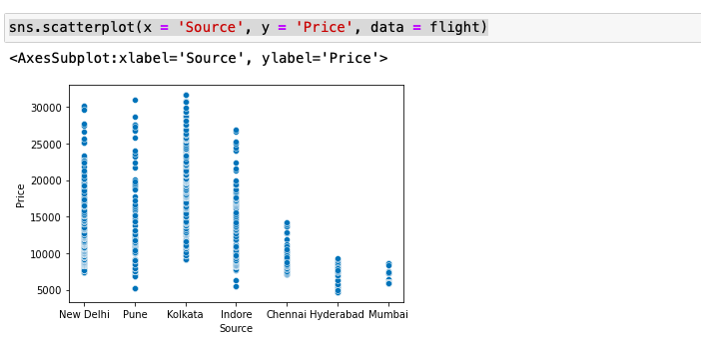
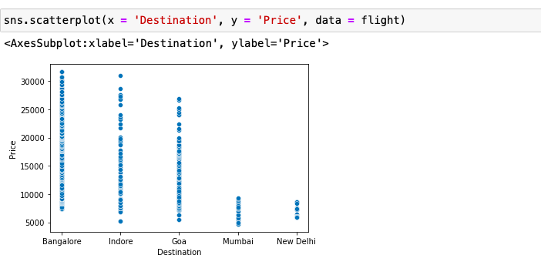
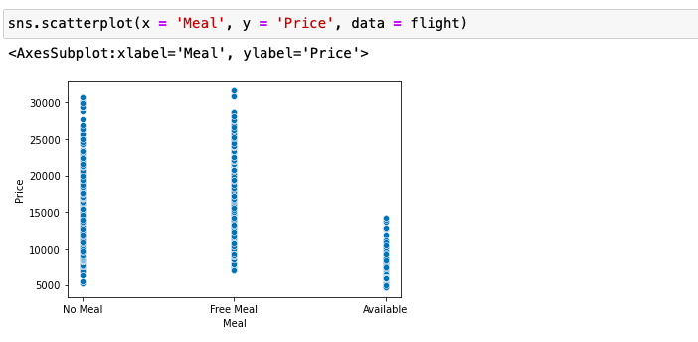
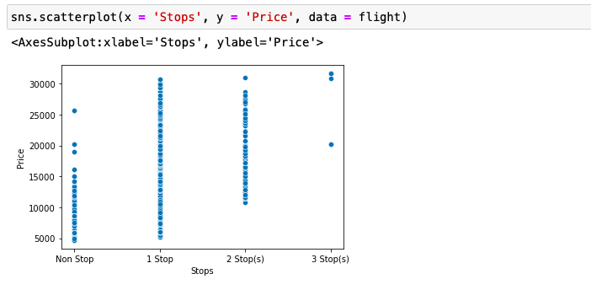
- Bivariate Analysis.

Slide 12
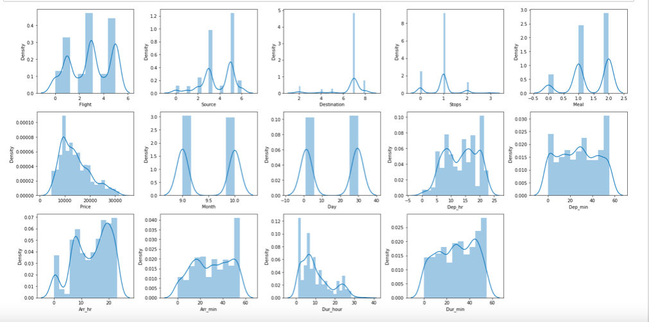
Normal Distribution

Slide 13
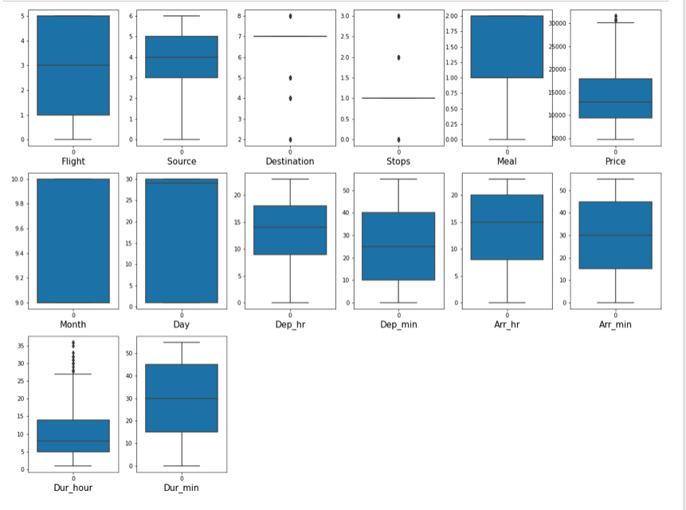
Outliers

Slide 14
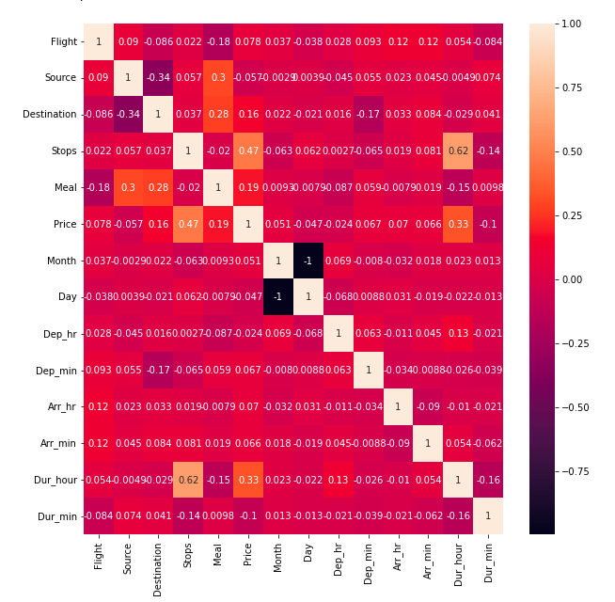
Correlation
No Multicolinearity problem present.

Slide 15
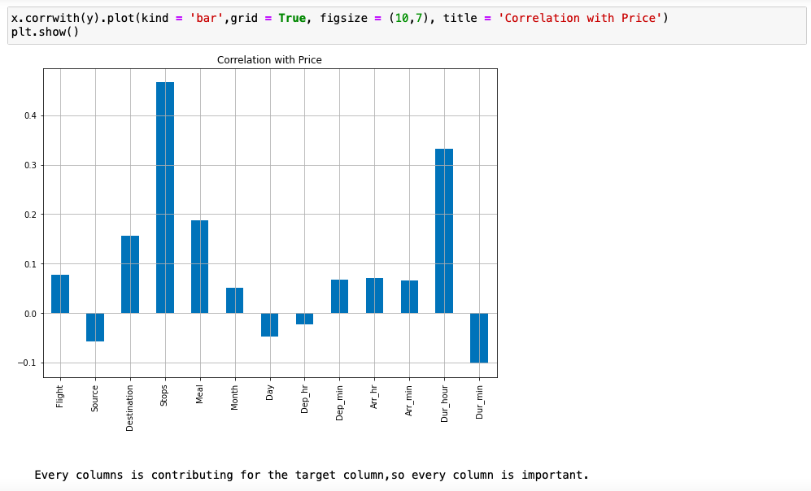
Correlation with Target Column.

Slide 16
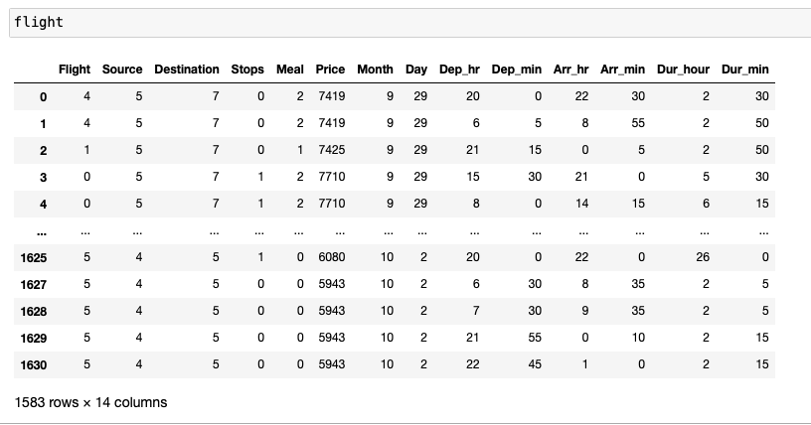
Final Dataset

Slide 17
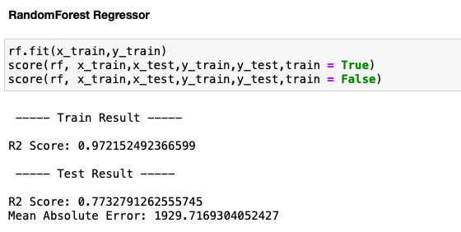
Best Model, Parameters & Score:
RandomForest Classifier.

Slide 18
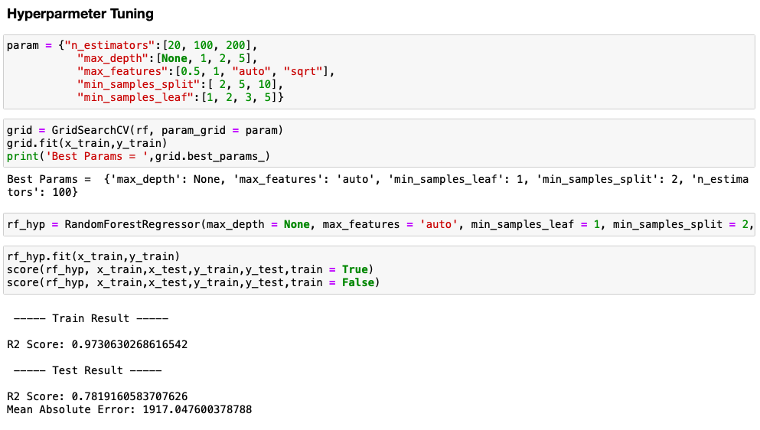
Hyperparameter Tuning & Best parameters.

